Slide 1

Automated Grading System Using Image Processing Innovations in Educational Technology
Presented By: Group 13
Bindu Lokesh
Vismitha Pulakkayaiah Yohanan
Balu Anush Anthu Kumar
Subject: Emerging Paradigms
Instructor: Dr. Pooya Moradian Zadeh

Slide 2


Introduction to Automated Grading
In the digital age, education continues to evolve with the integration of technology, aiming not only to enhance the learning experience but also to streamline administrative and evaluative tasks.
What is an Automated Grading System?

Slide 3
Problem Addressed
Automated Grading Systems address the challenges in education by significantly reducing the time and effort required for manual grading, mitigating human errors and bias to ensure fairness and consistency, and enhancing scalability to manage larger volumes of assessments efficiently.
The systems revolutionize the evaluation process, enabling educators to focus more on teaching and personalized feedback, thus improving the overall educational experience for both teachers and students.

Slide 4
Challenges in Traditional Grading
Time-Intensive
Inflexible
Scalability Limitation
Susceptible to Bias
Error-Prone

Slide 5
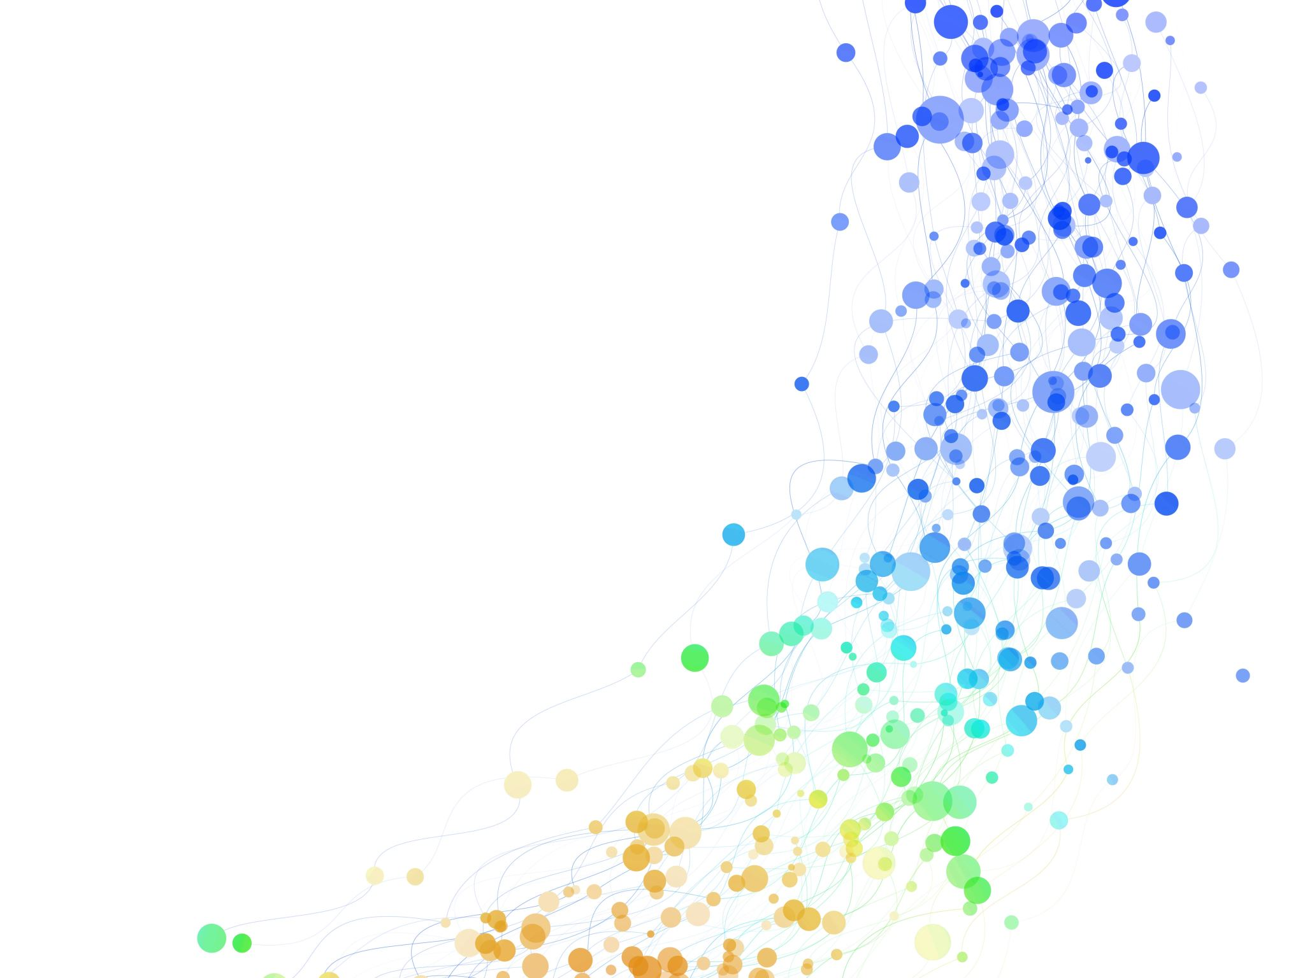
Importance and Application
Enhanced Efficiency: Reduces the grading workload on educators, enabling quicker turnaround for exam results.
Improved Accuracy: Automated systems reduce human error, providing more reliable assessment outcomes.
Scalability and Accessibility:: Automated systems ensure scalable grading for large classes and enhance accessibility for diverse learning environments, supporting equitable education.
Data-Driven Insights: Provides valuable analytics on student performance that can inform teaching strategies and curriculum development
Fairness and Objectivity: Standardizes grading to ensure all students are evaluated equally, promoting fairness.

Slide 6
Our Solution
The model is designed to process digital images of multiple-choice exam sheets and extract relevant information for grading purposes.
The model uses advanced image processing techniques to convert photographs or scans of multiple-choice exam sheets into a digital format that it can analyze.
The system detects the marked answers by analyzing the pattern and shading within the answer bubbles, using algorithms designed to recognize filled-in areas.
It ensures a high level of accuracy, reducing the possibility of human error in the grading process and providing a fair and consistent assessment for all students.

Slide 7

Technology
Python Programming Language
OpenCV (Open Source)
Computer Vision Library
SciPy's ndimage
Skimage (Scikit-image)
Pytesseract Pillow (PIL Fork)
NumPy
Matplotlib
Notes:
The script is written in Python, which is known for its robust libraries for scientific computing and image processing.
Used for various image processing tasks such as resizing images, converting to grayscale, detecting edges, finding contours, and perspective transformations.
Utilized for image manipulation and processing which might include tasks like filtering.
For image I/O and transformations like warping.
Imutils: A series of convenience functions to make basic image processing functions such as translation, rotation, resizing, skeletonization, and displaying Matplotlib images easier with OpenCV.
A Tesseract-OCR Engine wrapper for optical character recognition to extract text from images.
An imaging library to provide the Python interpreter with image editing capabilities.
Used for numerical processing, handling arrays of image pixel data, and other mathematical operations necessary for image processing.
A plotting library used for displaying images and other visualizations.

Slide 8
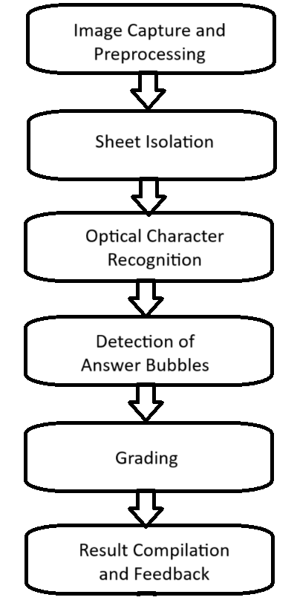
System
Workflow

Slide 9

Methodology
The methodology described in the script follows these steps:
Preprocessing images to enhance clarity and reduce noise.
Applying Canny edge detection and contour finding to isolate the exam sheet within the image.
By implementing perspective transformation to correct any distortion in the image to a top-down view of the sheet.
Detecting and grouping circular regions that correspond to answer bubbles using the Hough Circle Transform.

Slide 10
Methodology
Integrated OCR to extract printed text from the exam sheet.
Grading the exam by comparing detected answers to an answer key.
Superimposing the results on the exam image for a visual representation of the graded exam.

Slide 11
Demo

Slide 12

Our automated grading system demonstrated a 100 percent accuracy rate in testing, significantly surpassing traditional manual grading benchmarks. It not only reduced grading time substantially but also exhibited robust performance across diverse exam formats and varying image conditions. These results validate the system's potential to revolutionize exam grading by providing swift, consistent, and precise evaluations, promising a new standard for academic assessment.

Slide 13

Future Works
Machine Learning Integration: Implement advanced algorithms for answer recognition.
Support for Varied Formats: Adapt the system to grade diverse types of questions, including essays and short answers.
User Interface Enhancements: Develop a more intuitive interface to facilitate easier interaction for users of all technical skill levels.
Real-time Feedback: Enable instant grading capabilities for immediate student feedback.
Data Security Measures: Ensure the privacy and security of student data with encryption and secure access protocols.

Slide 14

Conclusion
In conclusion, the automated grading system presented in this project offers a practical solution for streamlining the evaluation process in educational settings. By leveraging image processing and OCR technologies, the system achieves accurate and efficient grading of multiple-choice exams.

Slide 15

References
[1] Smith, J., & Johnson, A. (2020). Automated Grading Systems in Education: A Comprehensive Review. Journal of Educational Technology, 28(2), 123-145.
[2] Wang, L., & Liu, C. (2019). Image Processing Techniques for Automated Grading of Multiple-Choice Exams. IEEE Transactions on Education, 62(3), 187-202.
[3] Zhang, Y., & Li, H. (2018). Deep Learning Approaches for Optical Mark Recognition in Grading Exams. ACM Transactions on Intelligent Systems, 12(4), 56-68.

Slide 16
Any questions?

Slide 17


